Slide 1
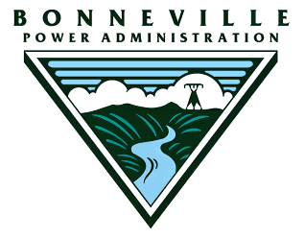
Willamette Dams Power Share by Project (Capital/O&M)
Detroit 40.5% / 50.5%
Big Cliff (ReReg) 100% / 100%
Green Peter 49.5% / 45%
Foster (ReReg)* 49.5% / 45%
Hills Creek 24.5% / 21.5%
Lookout Point 31% / 36%
Dexter (ReReg) 100% / 100%
Cougar 23% / 19.5%
Dorena, Cottage Grove, Blue River, Fern Ridge, and Fall Creek have no power share and zero Federal generation
Aggregate Power Dams 46.06%
Aggregate Total System 32.154%
* Foster functions as a ReReg for Green Peter, however, an unregulated portion of the S. Santiam river drains into Foster reservoir, so it also provides flood control.

